Slide 1
Linear Algebra

Slide 2
Geometry
A scalar is a quantity which has magnitude only, e.g., temperature, mass, pressure.
Many other quantities are not sufficiently defined by their magnitude alone, e.g., displacement, velocity, magnetic field. These quantities involve both a magnitude and direction. Such quantities are called vectors.
Vectors can be represented by a directed line segment.

Slide 3
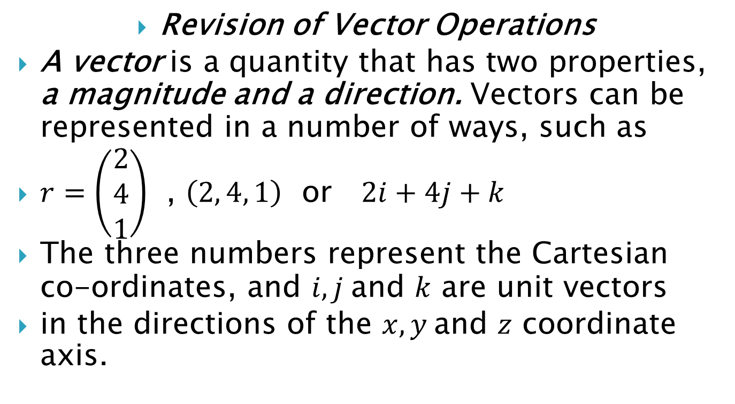
Revision of Vector Operations
A vector is a quantity that has two properties, a magnitude and a direction. Vectors can be represented in a number of ways, such as
$r=\left(\begin{matrix}2 \\ 4 \\ 1\end{matrix}\right)$ , $\left(2, 4, 1\right)$ or $2i+4j+k$
The three numbers represent the Cartesian co-ordinates, and $i, j$and $k$ are unit vectors
in the directions of the $x, y$and $z$ coordinate axis.

Slide 4
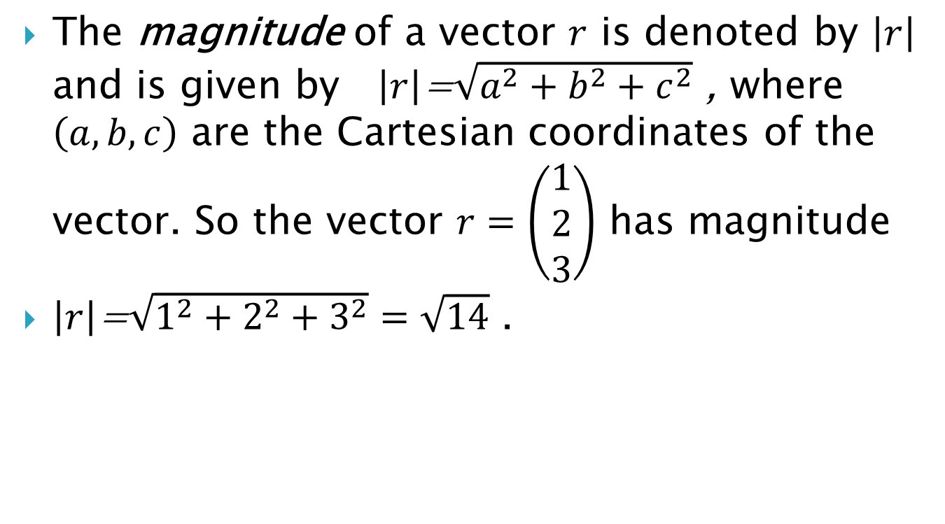
The magnitude of a vector $r$ is denoted by $\left|r\right|$ and is given by $\left|r\right|$=$\sqrt{a^{2}+b^{2}+c^{2}}$ , where $\left(a, b, c\right)$ are the Cartesian coordinates of the vector. So the vector $r=\left(\begin{matrix}1 \\ 2 \\ 3\end{matrix}\right)$ has magnitude
$\left|r\right|$=$\sqrt{1^{2}+2^{2}+3^{2}}=\sqrt{14}$ .

Slide 5
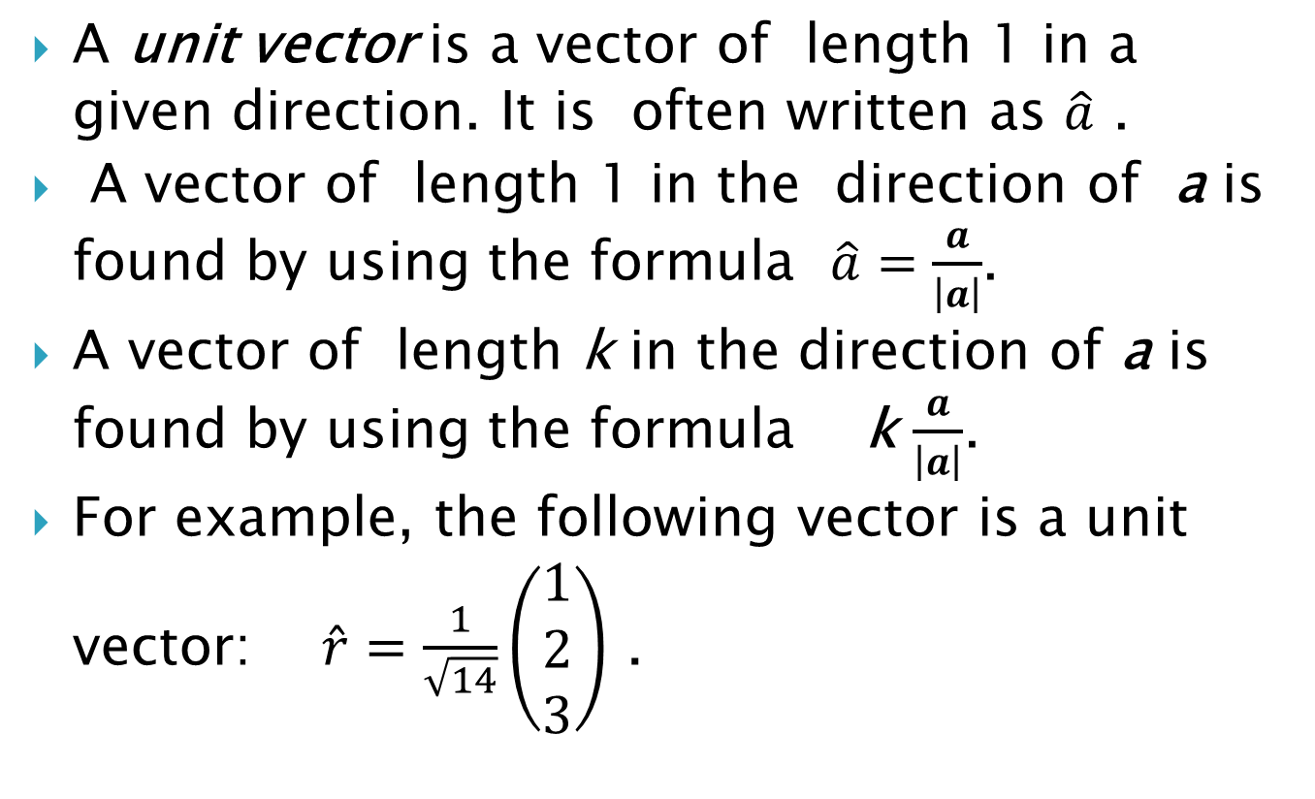
A unit vector is a vector of length 1 in a given direction. It is often written as $\hat{a}$ .
A vector of length 1 in the direction of a is found by using the formula $\hat{a}=\frac{a}{\left|a\right|}$.
A vector of length k in the direction of a is found by using the formula k $\frac{a}{\left|a\right|}$.
For example, the following vector is a unit vector: $\hat{r}=\frac{1}{\sqrt{14}}\left(\begin{matrix}1 \\ 2 \\ 3\end{matrix}\right)$ .

Slide 6
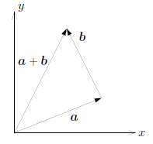
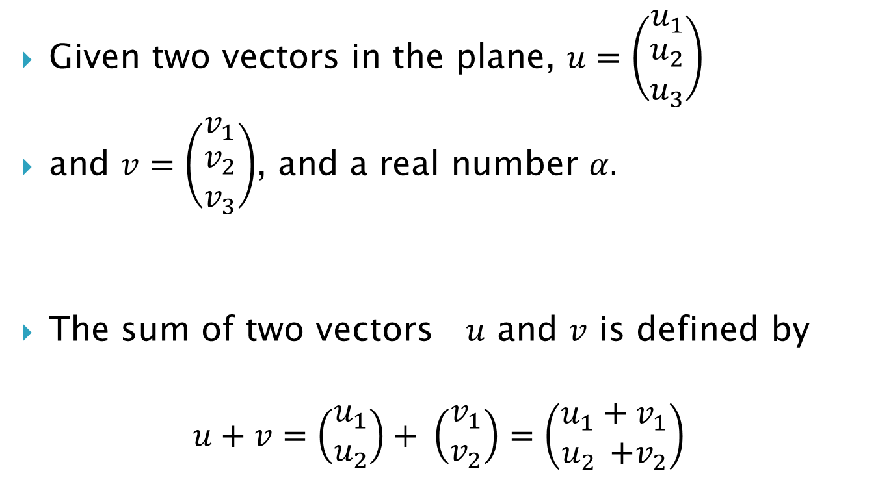
Vector addition
Given two vectors in the plane, $u=\left(\begin{matrix}u_{1} \\ \begin{aligned}u_{2} \\ u_{3}\end{aligned}\end{matrix}\right)$
and $v=\left(\begin{matrix}v_{1} \\ \begin{aligned}v_{2} \\ v_{3}\end{aligned}\end{matrix}\right)$, and a real number $α.$
The sum of two vectors $u$ and $v$ is defined by
$$u+v=\left(\begin{matrix}u_{1} \\ u_{2}\end{matrix}\right)+ \left(\begin{matrix}v_{1} \\ v_{2}\end{matrix}\right)=\left(\begin{matrix}u_{1}+v_{1} \\ u_{2 }{+v}_{2}\end{matrix}\right)$$

Slide 7
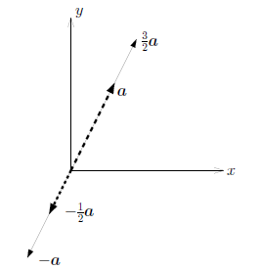

Multiplication by a scalar
The product of a scalar $α$ and a vector $u$ is defined by
$$αu=\left(\begin{matrix}{αu}_{1} \\ αu_{2}\end{matrix}\right)$$

Slide 8
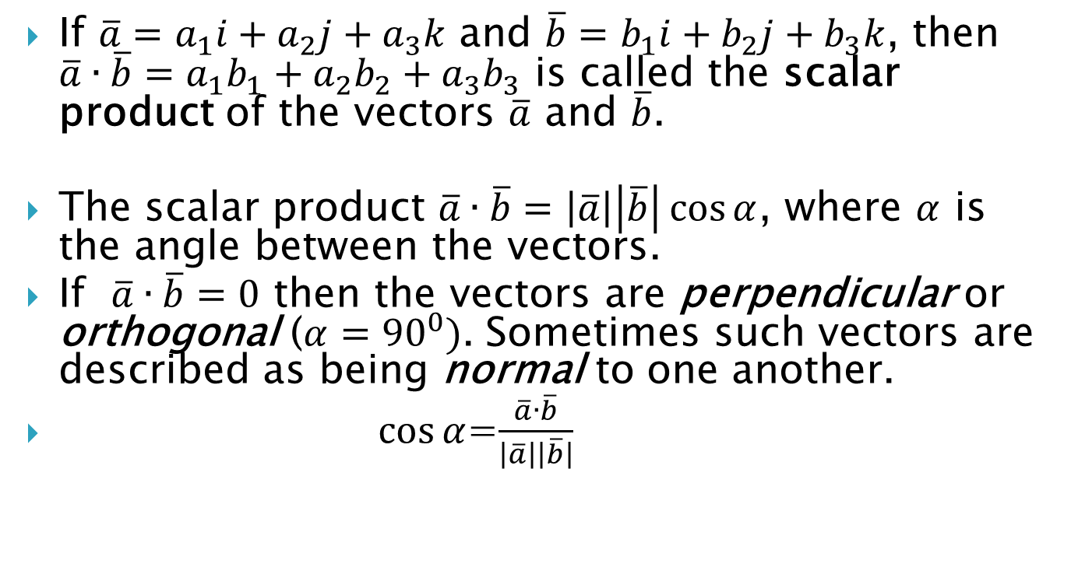
Scalar product
If $\overline{a}=a_{1}i+a_{2}j+a_{3}k$ and $\overline{b}=b_{1}i+b_{2}j+b_{3}k$, then $\overline{a}∙\overline{b}=a_{1}b_{1}+a_{2}b_{2}+a_{3}b_{3}$ is called the scalar product of the vectors $\overline{a}$ and $\overline{b}$.
The scalar product $\overline{a}∙\overline{b}=\left|\overline{a}\right|\left|\overline{b}\right|\cos{α}$, where $α$ is the angle between the vectors.
If $\overline{a}∙\overline{b}=0$ then the vectors are perpendicular or orthogonal ($α={90}^{0})$. Sometimes such vectors are described as being normal to one another.
$\cos{α}$=$\frac{\overline{a}∙\overline{b}}{\left|\overline{a}\right|\left|\overline{b}\right|}$

Slide 9
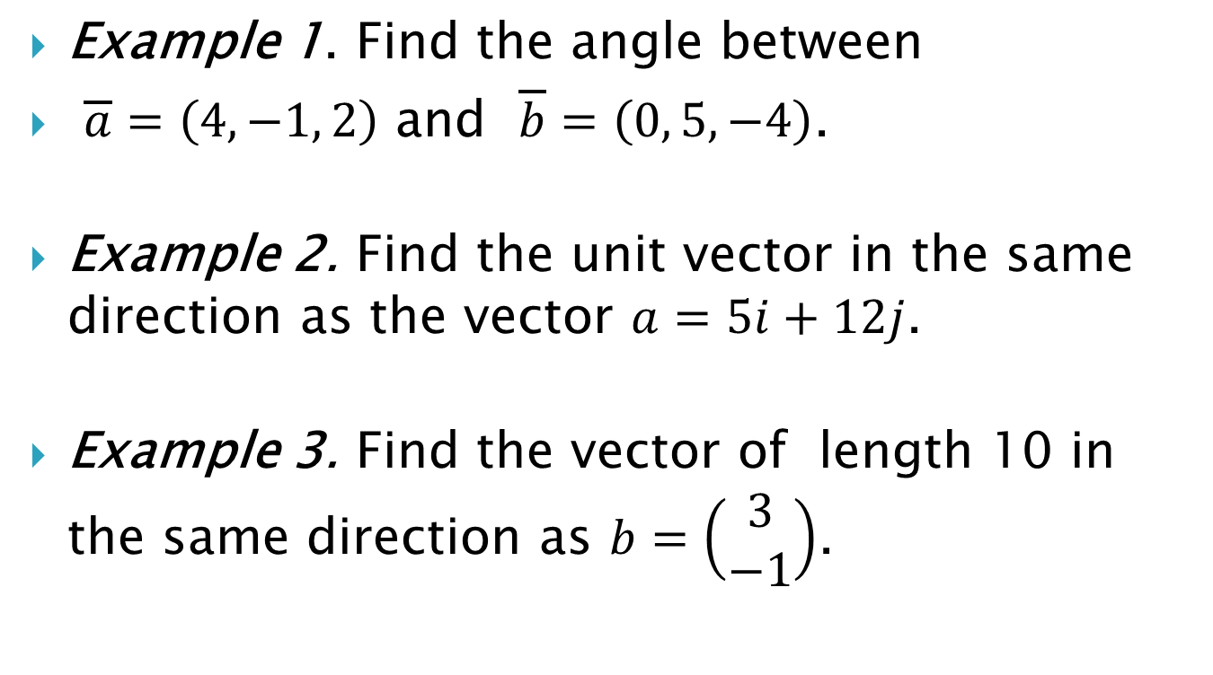
Example 1. Find the angle between
$\overline{a}=\left(4, −1, 2\right)$ and $\overline{b}=\left(0, 5, −4\right)$.
Example 2. Find the unit vector in the same direction as the vector $a=5i+12j$.
Example 3. Find the vector of length 10 in the same direction as $b=\left(\begin{matrix}3 \\ −1\end{matrix}\right)$.

Slide 10
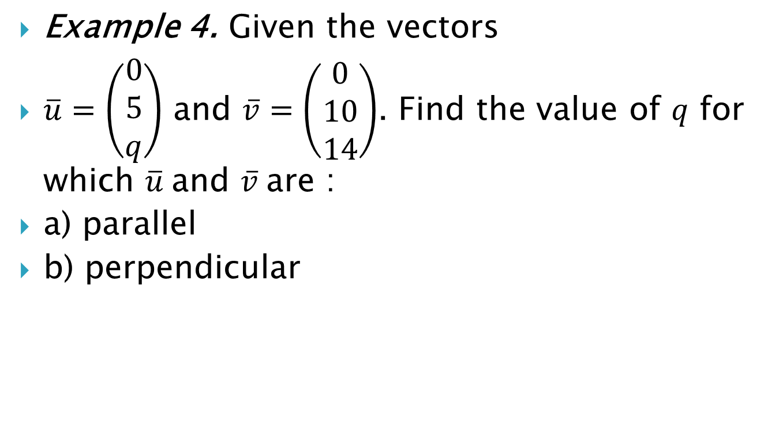
Example 4. Given the vectors
$\overline{u}=\left(\begin{matrix}0 \\ 5 \\ q\end{matrix}\right)$ and $\overline{v}=\left(\begin{matrix}0 \\ 10 \\ 14\end{matrix}\right)$. Find the value of $q$ for which $\overline{u}$and $\overline{v}$are :
a) parallel
b) perpendicular

Slide 11
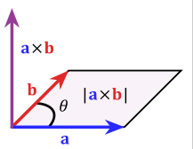
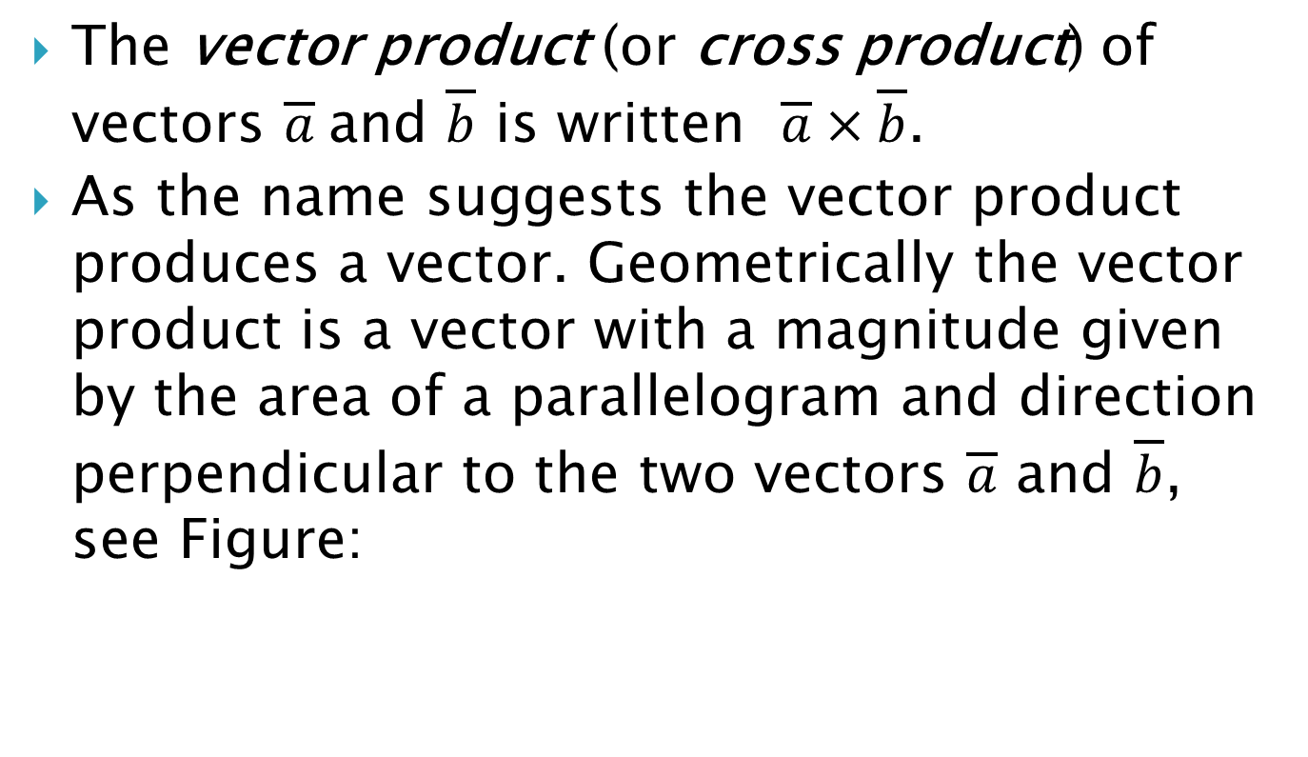
Vector product
The vector product (or cross product) of vectors $\overline{a}$and $\overline{b}$ is written $\overline{a}×\overline{b}$.
As the name suggests the vector product produces a vector. Geometrically the vector product is a vector with a magnitude given by the area of a parallelogram and direction perpendicular to the two vectors $\overline{a}$ and $\overline{b}$, see Figure:

Slide 12
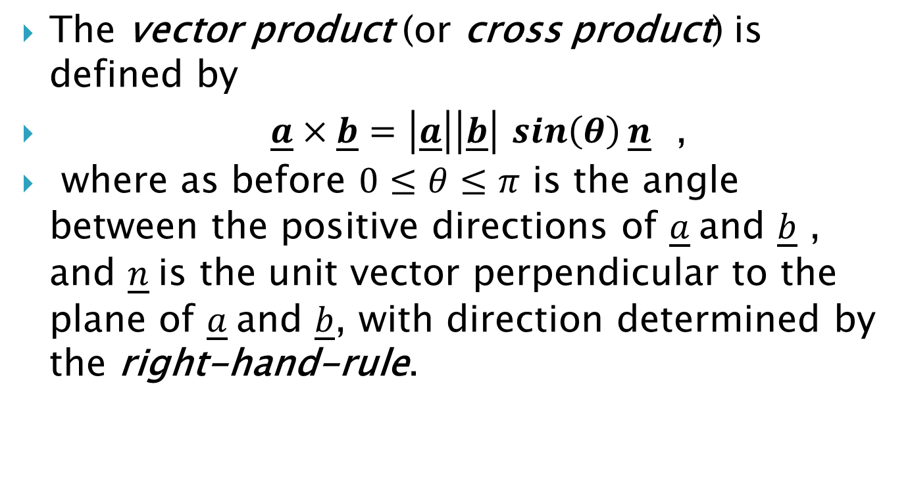
The vector product (or cross product) is defined by
$\underline{a}×\underline{b}=\left|\underline{a}\right|\left|\underline{b}\right|$ $\sin\left(θ\right)\underline{n}$ ,
where as before $0≤θ≤π$ is the angle between the positive directions of $\underline{a}$and $\underline{b}$ , and $\underline{n}$is the unit vector perpendicular to the plane of $\underline{a}$and $\underline{b}$, with direction determined by the right-hand-rule.

Slide 13
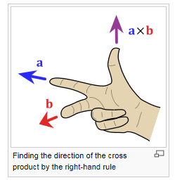
"Right Hand Rule"
With your right-hand, point your index finger (forefinger) along vector a, and point your middle finger along vector b: the cross product goes in the direction of your thumb.

Slide 14
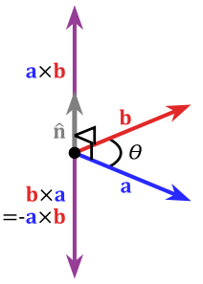
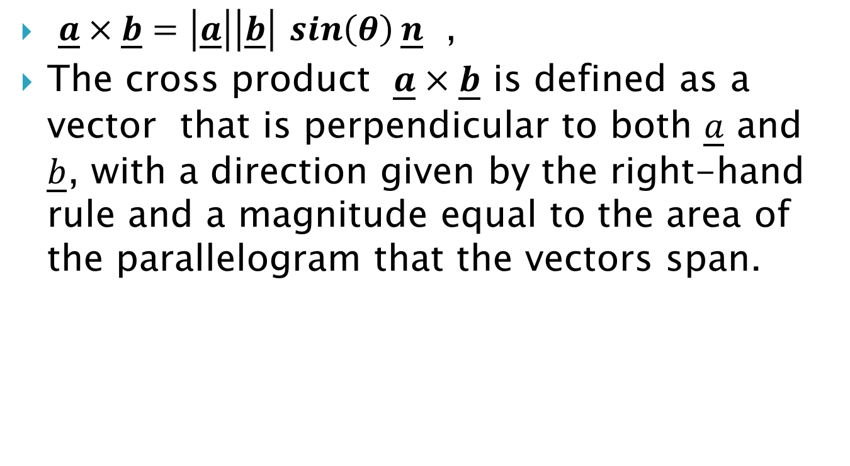
$\underline{a}×\underline{b}=\left|\underline{a}\right|\left|\underline{b}\right|$ $\sin\left(θ\right)\underline{n}$ ,
The cross product $\underline{a}×\underline{b}$ is defined as a vector that is perpendicular to both $\underline{a}$ and $\underline{b}$, with a direction given by the right-hand rule and a magnitude equal to the area of the parallelogram that the vectors span.

Slide 15
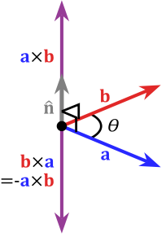
By pointing the forefinger toward b first, and then pointing the middle finger toward a, the thumb will be forced in the opposite direction, reversing the sign of the product vector. So the cross-product is anti-commutative, i.e.,
b × a = −(a × b).

Slide 16
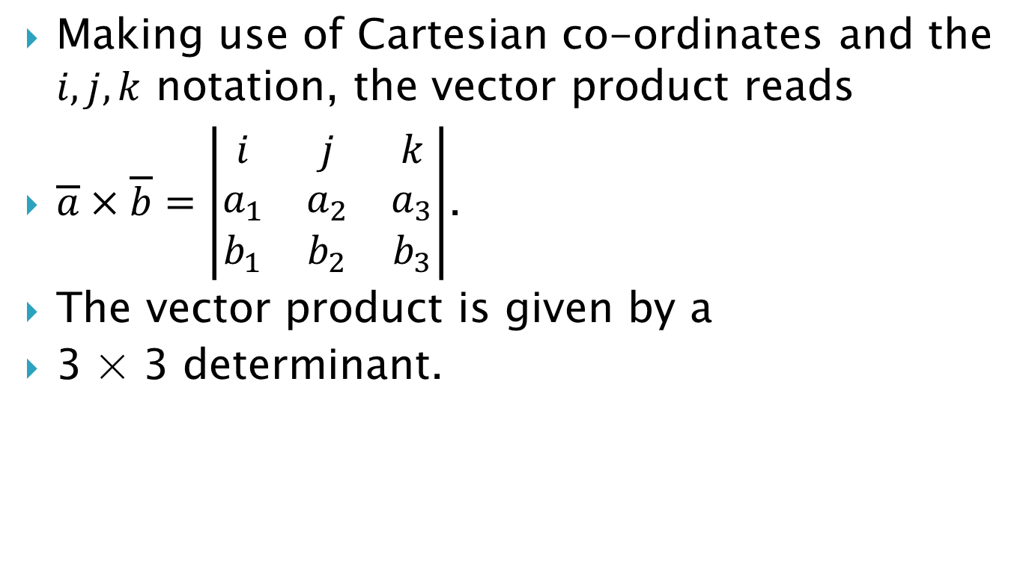
Making use of Cartesian co-ordinates and the $i, j, k$ notation, the vector product reads
$\overline{a}×\overline{b}=\left|\begin{matrix}i & j & k \\ a_{1} & a_{2} & a_{3} \\ b_{1} & b_{2} & b_{3}\end{matrix}\right|$.
The vector product is given by a
3 × 3 determinant.

Slide 17
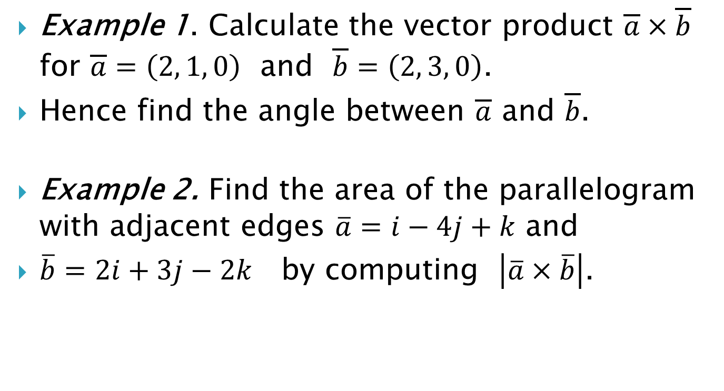
Example 1. Calculate the vector product $\overline{a}×\overline{b}$ for $\overline{a}=\left(2, 1, 0\right)$ and $\overline{b}=\left(2, 3, 0\right)$.
Hence find the angle between $\overline{a}$ and $\overline{b}$.
Example 2. Find the area of the parallelogram with adjacent edges $\overline{a}=i−4j+k$ and
$\overline{b}=2i+3j−2k$ by computing $\left|\overline{a}×\overline{b}\right|$.

Slide 18
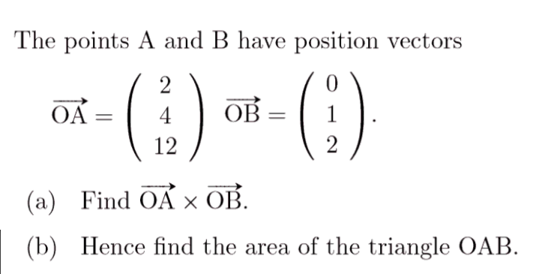
Example 3.

Slide 19
Vector spaces
The operations of addition and scalar multiplication are used in many diverse contexts in mathematics. A general theory of mathematical systems involving
addition and scalar multiplication will be applicable to many areas in mathematics.
Mathematical systems of this form are called vector spaces or linear spaces.

Slide 20
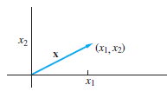
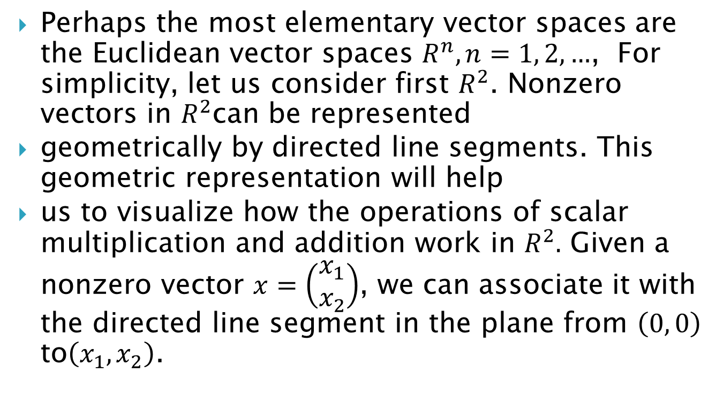
Perhaps the most elementary vector spaces are the Euclidean vector spaces $R^{n}, n=1, 2, …$, For simplicity, let us consider first $R^{2}$. Nonzero vectors in $R^{2}$can be represented
geometrically by directed line segments. This geometric representation will help
us to visualize how the operations of scalar multiplication and addition work in $R^{2}.$ Given a nonzero vector $x=\left(\begin{matrix}x_{1} \\ x_{2}\end{matrix}\right)$, we can associate it with the directed line segment in the plane from $\left(0, 0\right)$ to$\left(x_{1}, x_{2}\right)$.

Slide 21
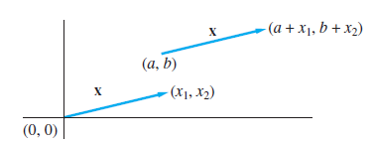

If we equate line segments that
have the same length and direction, $x$ can be represented by any line segment from $\left(a, b\right)$to $\left(a+x_{1}, b+x_{2}\right)$.

Slide 22
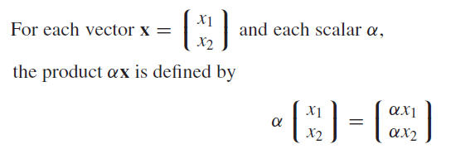
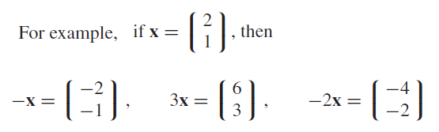
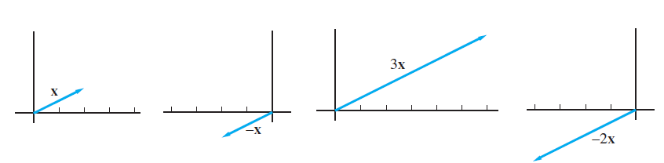

Slide 23

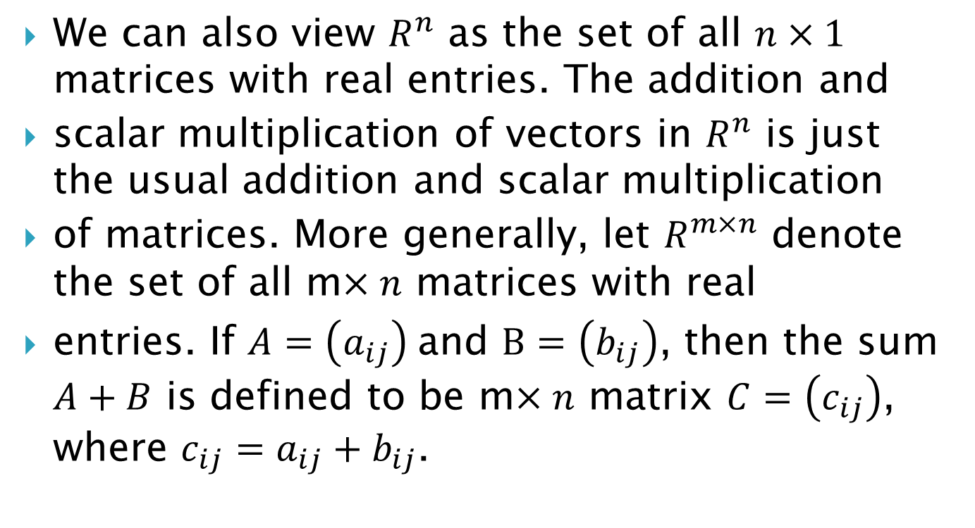
Vector space $R^{m×n}$
We can also view $R^{n}$ as the set of all $n×1$ matrices with real entries. The addition and
scalar multiplication of vectors in $R^{n}$ is just the usual addition and scalar multiplication
of matrices. More generally, let $R^{m×n}$ denote the set of all m$×n$ matrices with real
entries. If $A=\left(a_{ij}\right)$and $B=\left(b_{ij}\right)$, then the sum $A+B$ is defined to be m$×n$ matrix $C=\left(c_{ij}\right)$, where $c_{ij}=a_{ij}+b_{ij}$.

Slide 24
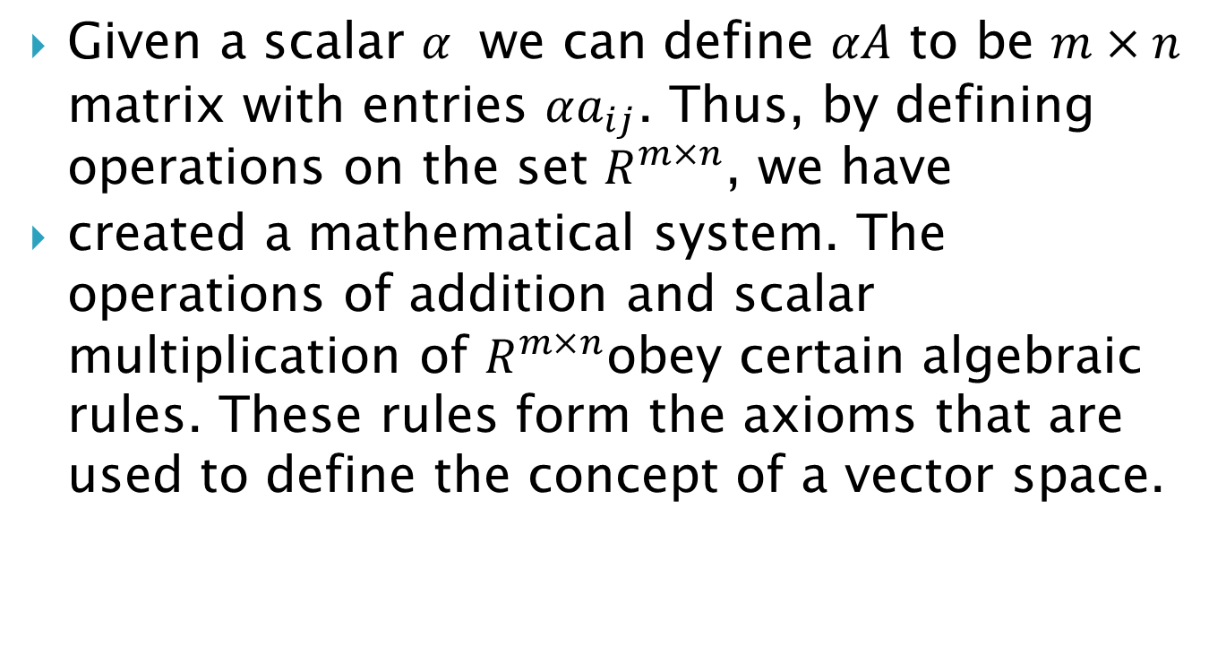
Given a scalar $α$ we can define $αA$ to be $m×n$ matrix with entries $αa_{ij}$. Thus, by defining operations on the set $R^{m×n}$, we have
created a mathematical system. The operations of addition and scalar multiplication of $R^{m×n}$obey certain algebraic rules. These rules form the axioms that are used to define the concept of a vector space.

Slide 25
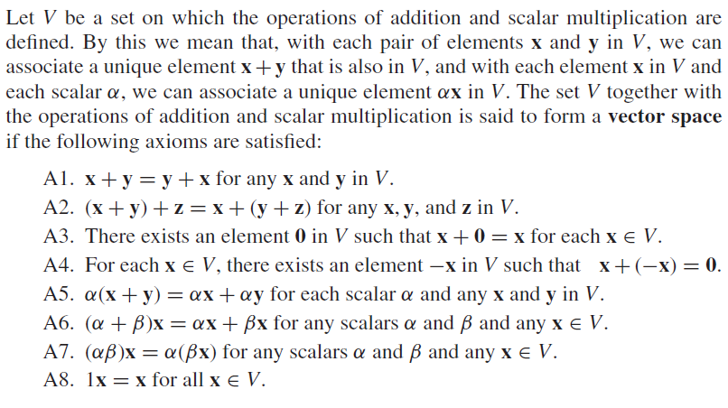
Vector space axioms

Slide 26

We will refer to the set V as the universal set for the vector space. Its elements are
called vectors and are usually denoted by boldface letters such as u, v, w, x, y, and z.
The term scalar will generally refer to a real number, although in some cases it will be
used to refer to complex numbers. An important component of the definition is the closure properties of the two operations. These properties can be summarized as follows:

